Slide 1
Basic Details of the team and problem statement
Problem Statement : Develop innovative product concepts leveraging analytical and AI techniques to drive value in the life sciences domain
Proposed Solution : Personalized medical recommendation system
Team Name : SEEKERS
Team Leader : Hanumanth Kumar M
Department : CTech
Team Members :
Teja Dalayai – RA2111003011593
Abhinash Gunda – RA2111003010850
Manikanta Perumalla – RA2111003010745

Slide 2
Idea/Approach Details:
To implement personalized medial recommendation system
Individualized Healthcare:
Medical recommendations to the unique health conditions of each individual.
Enhanced Diagnosis Accuracy:
Improve accuracy by leveraging AI to analyse extensive health data.
Adaptive Workouts and Diet Plans:
Provide personalized fitness and dietary recommendations based on individual factors.
Predict Disease:
Predict and identify diseases based on symptoms, providing corresponding prescriptions for effective medical guidance.
Precautions:
Precautions entail safety measures to be
adopted when experiencing
specific symptoms.
Technology Stack:
Python(pandas, SKlearn, TensorFlow, pickle, Numpy)
Machine Learning
Deep learning
Pandas
HTML, CSS
Flask

Slide 3
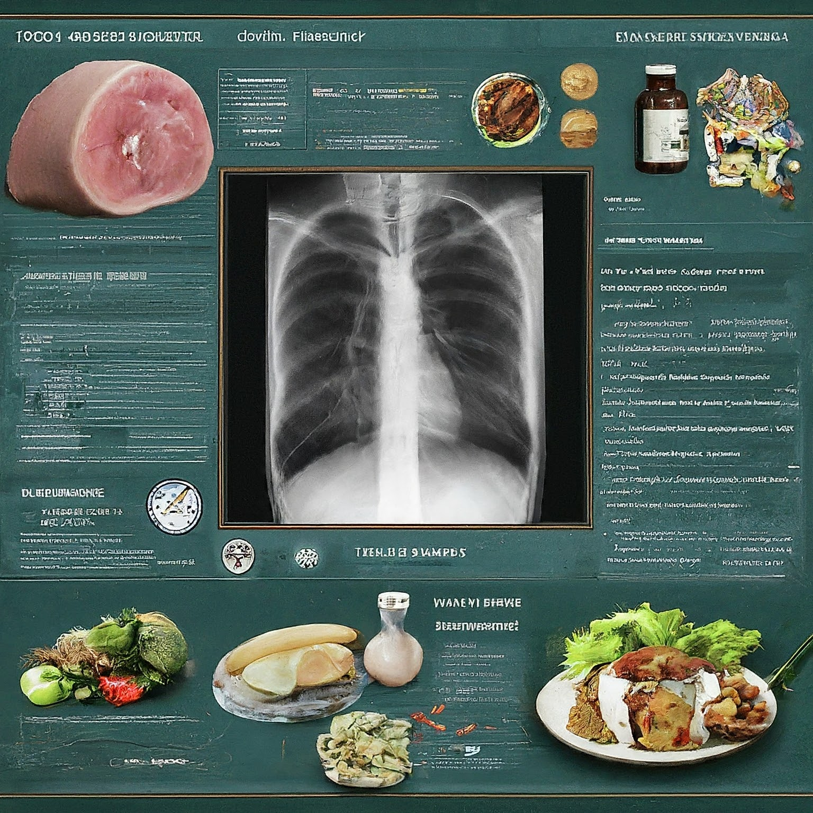


Model Flow
Symptoms
Model
Disease
Description
Symptoms are input into a trained model, which processes the information and generates an output containing the name of the disease, a description of the condition, recommended dietary guidelines, and suggested workout routines.
Precaution
Workouts
Diets
Medication

Slide 4


